Slide 1
Big Data Integration & Processing
India vs USA on job payment & total company expense
Instructor: Dr. Vu Tuyet Trinh
Student: Group 8 - Le Hoang Long - 20232099M - long.lh232099m@sis.hust.edu.vn

Slide 2
Problem statement
Project aims:
Concentrating on comparison of job differences between New York and India
Concentrating on course content, we have no intent of creating a fully functional application.
Data sources :
Indian job data file is stored on Hadoop file system
New York job data file is stored on Linux file system
Tasks
Data integration
Load data from different source
Normalize the data
Standardize the data
Tie different sources controlled by many people, unders a common schema
Data processing
Compare each pair aspect of data views
Come up to conclusions

Slide 3
Source code
Data integration
https://colab.research.google.com/drive/1mR18G7ydQaMQXFEydzwmqIvR-SDm9O1O?usp=sharing
Data processing
https://colab.research.google.com/drive/1fI6Gn77QEPJqXG2CQuYoptfyEN215jpG?usp=sharing

Slide 4
Data source
Linux file system
Name : Jobs_NYC_Postings.csv
Size: 37MB
Source: https://catalog.data.gov/dataset/nyc-jobs
Format : CSV
Hadoop file system
Name: large_naukri_data.json
Size : 43MB
Source: https://www.naukri.com/json-data-jobs-2360
Format: JSON

Slide 5
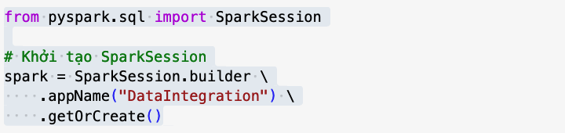
Data loading from different sources
Spark setup
Hadoop file system data loading
indian_jobs=spark.read.json("hdfs://localhost:9000/user/u1/large_naukri_data.json")
Linux system data loading
nyc_jobs = spark.read.csv('Jobs_NYC_Postings.csv', header=True)

Slide 6
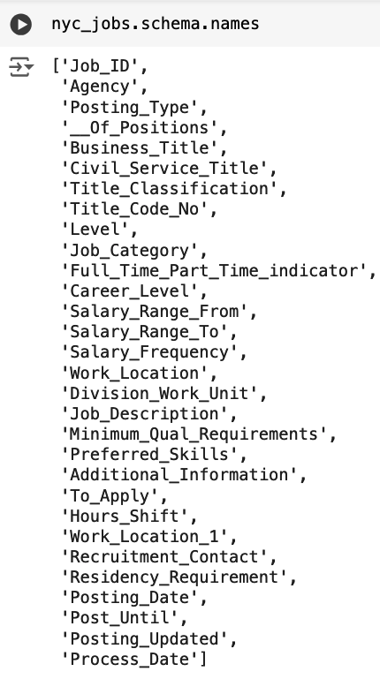
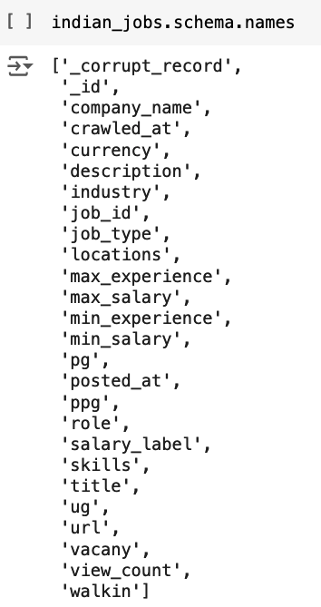
Data schema
New York
job shema
in CSV format
India job schema
in JSON format

Slide 7
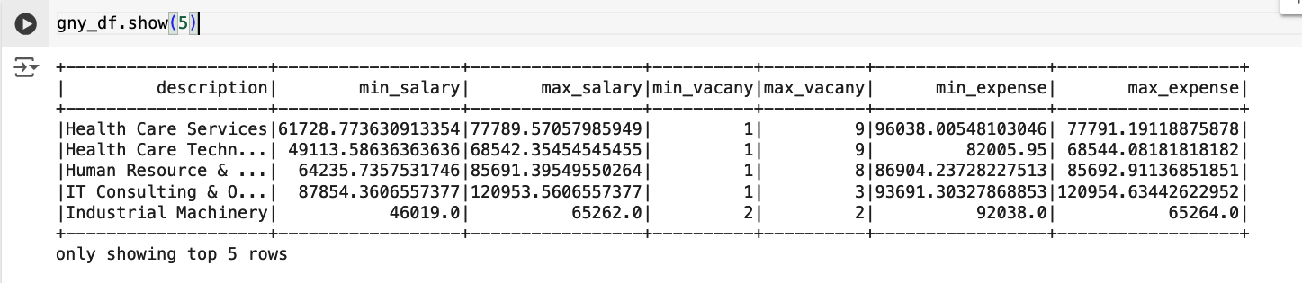
Expected Data Schema
Semantic mappings

Slide 8
Data integrating tasks
New York data source
Rename column
“Job Position” to “vacancy”
“Salary Ranged From” to “minimum salary”
“Salary Ranged To” to “max salary”
“Job_Category” to “industry”
“Full_Time_Part_Time” to “job type”
Generate a new column named “description” from columns:
Industry
Agency
Civil_Service_Title
Role
Indian data source
Convert salary currency from INR to USD
Generate a new column named “description” from columns:
Industry
Role
Skills

Slide 9
Applying an Machine Learning model to convert job description to job name
from transformers import AutoTokenizer, AutoModelForSequenceClassification, pipeline
tokenizer = AutoTokenizer.from_pretrained("sampathkethineedi/industry-classification")
model = AutoModelForSequenceClassification.from_pretrained("sampathkethineedi/industry-classification")
industry_tags = pipeline('sentiment-analysis', model=model, tokenizer=tokenizer)

Slide 10
Indian data preprocessing
Select columns that would be used in processing phrase
id_col = ['industry', #'job_type', #'min_experience','max_experience',
'min_salary', 'max_salary', 'skills', 'vacany', 'role']
id_df = spark.sql(f'select {",".join(id_col)} from indian_view where industry is not null').collect()
id_df = spark.createDataFrame(id_df)

Slide 11
Indian data preprocessing
Convert salary amount from Indian rupee to US dollar
id_df = id_df.withColumn('max_salary', id_df['max_salary'] * 0.012)
id_df = id_df.withColumn('min_salary', id_df['min_salary'] * 0.012)

Slide 12
Indian data preprocessing
Standardize job description
def id_industry_tags_udf(industry, role, skills):
return industry_tags(f"{industry}, {role}, {skills}")[0]['label']
def id_industry_tags_udf_score(industry, role, skills):
return industry_tags(f"{industry}, {role}, {skills}")[0]['score']
# Register the UDF
id_industry_tags_udf = udf(id_industry_tags_udf, StringType())
id_industry_tags_udf_score = udf(id_industry_tags_udf_score, DoubleType())
id_df = id_df.withColumn('description', id_industry_tags_udf(id_df['industry'], id_df['role'], id_df['skills']))

Slide 13
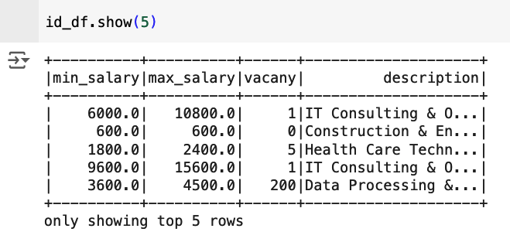
Indian data preprocessing, Result

Slide 14
Generate expense of each Indian job description
id_df = id_df.withColumn('min_expense', id_df['min_salary'] * id_df['vacany'])
id_df = id_df.withColumn('max_expense', id_df['max_salary'] + id_df['vacany'])

Slide 15
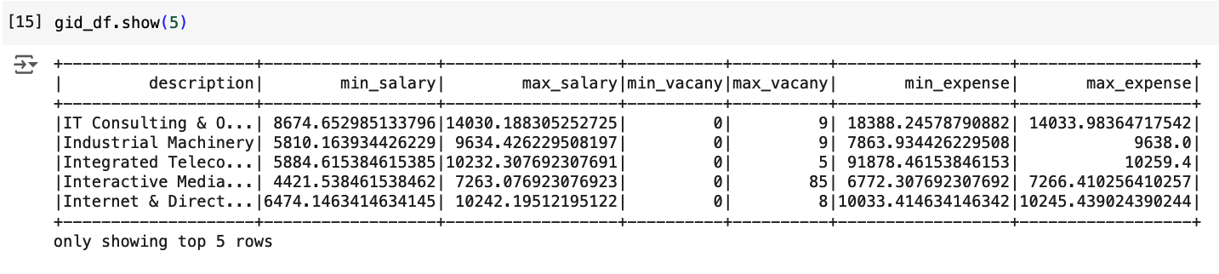
Create the global view for Indian job data source
query = 'select description, avg(min_salary) as min_salary, avg(max_salary) as max_salary, \
min(vacany) as min_vacany, max(vacany) as max_vacany, avg(min_expense) as min_expense, \
avg(max_expense) as max_expense from '
gid_df = spark.sql(f'{query} gny_view group by description').collect()
gid_df = spark.createDataFrame(gid_df)

Slide 16
New York data preprocessing
Select columns that would be used in processing phrase
Name of some columns are altered to meet the standard name
ny_col = [ 'Agency', 'Job_Category as industry', 'Full_Time_Part_Time_indicator as job_type',
'Salary_Range_From as min_salary', 'Salary_Range_To as max_salary',
'__Of_Positions as vacany', 'Business_Title as role', 'Civil_Service_Title' ]
ny_df = spark.sql(f'select {",".join(ny_col)} from nyc_view where Full_Time_Part_Time_indicator = \'F\' ').collect()
ny_df = spark.createDataFrame(ny_df)

Slide 17
New York data preprocessing
Standardize job description
def industry_tags_udf(industry, role, title, agency):
return industry_tags(f"{industry}, {role}, {title}, {agency}")[0]['label']
def industry_tags_udf_score(industry, role, title, agency):
return industry_tags(f"{industry}, {role}, {title}, {agency}")[0]['score']
# Register the UDF
industry_tags_udf = udf(industry_tags_udf, StringType())
industry_tags_udf_score = udf(industry_tags_udf_score, DoubleType())
ny_df = ny_df.withColumn('description', industry_tags_udf(
ny_df['industry'], ny_df['role'], ny_df['Civil_Service_Title'], ny_df['Agency']))

Slide 18
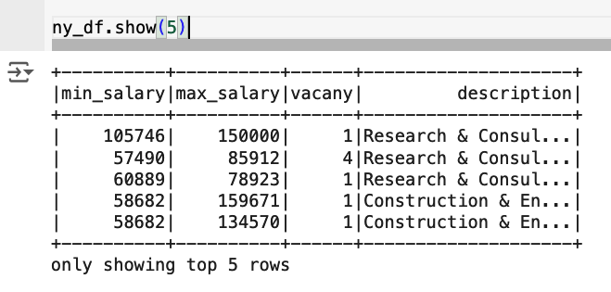
New York data preprocessing, result

Slide 19
Generate expense of each New York job description &
Create the global view for New York job data source
ny_df = ny_df.withColumn('min_expense', ny_df['min_salary'] * ny_df['vacany'])
ny_df = ny_df.withColumn('max_expense', ny_df['max_salary'] + ny_df['vacany'])
query = 'select description, avg(min_salary) as min_salary, avg(max_salary) as max_salary, \
min(vacany) as min_vacany, max(vacany) as max_vacany, avg(min_expense) as min_expense, \
avg(max_expense) as max_expense from '
gny_df = spark.sql(f'{query} gny_view group by description').collect()
gny_df = spark.createDataFrame(gny_df)

Slide 20
Global view of New York data source

Slide 21
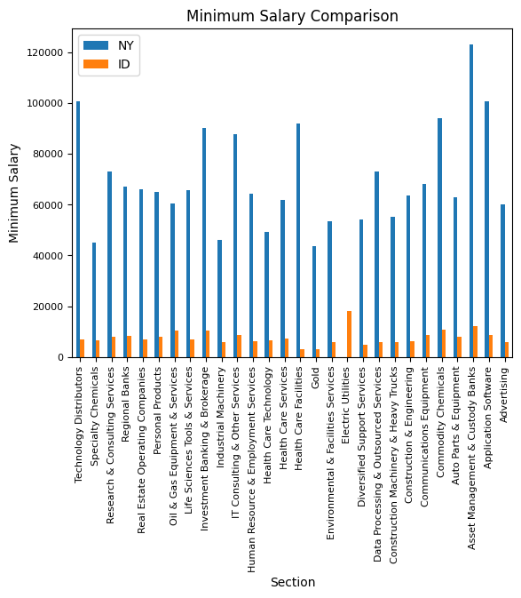
Data processing
Minimum salary comparison
The paying rate of Indian companies is much less than the paying rate of New York companies
The exceptional case is in “Electric Utilities” section
It seems that New York shifted their investment off “Electric Utilities” section
Source code
query = "SELECT ny.description, ny.min_salary as NY, id.min_salary as ID \
FROM gny_df ny inner join gid_df id on ny.description = id.description \
order by ny.description desc"
min_salary = spark.sql(query).collect()
min_salary = spark.createDataFrame(min_salary)
draw_chart(min_salary, 'Minimum Salary Comparison', 'Minimum Salary')

Slide 22
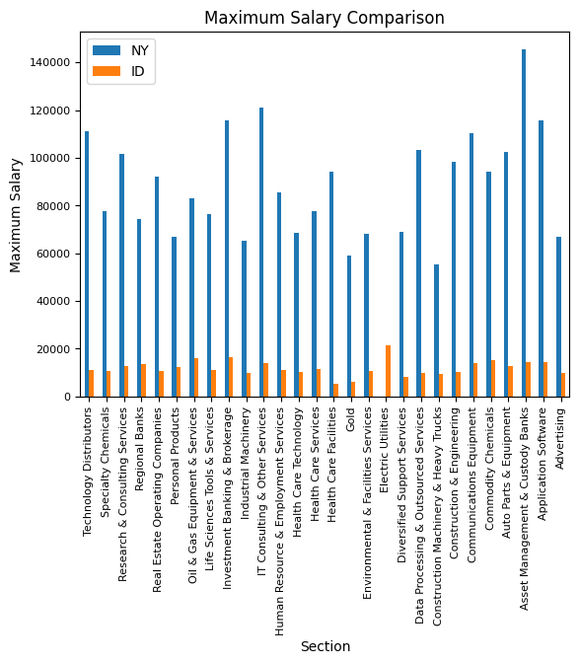
Data processing
Maximum salary comparison
New York average payment is 10 times larger than Indian average payment
Source code
query = "SELECT ny.description, ny.max_salary as NY, id.max_salary as ID \
FROM gny_df ny inner join gid_df id on ny.description = id.description \
order by ny.description desc"
max_salary = spark.sql(query).collect()
max_salary = spark.createDataFrame(max_salary)
draw_chart(max_salary, 'Maximum Salary Comparison', 'Maximum Salary')

Slide 23
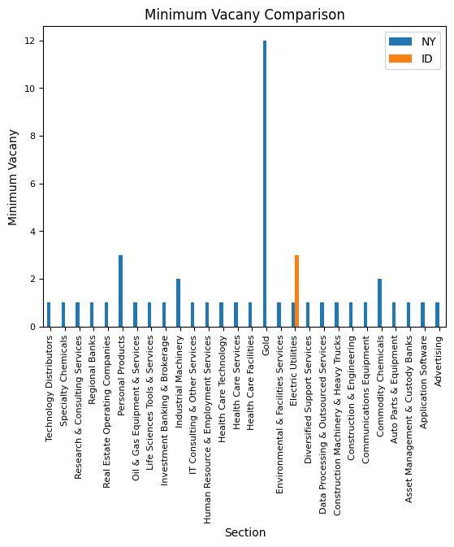
Data processing
Minimum vacancy comparison
New York jobs always have some vacancies
Indian jobs frequently runs out of vacancy in short time except “Electric Utilities” section
Source code:
query = "SELECT ny.description, ny.min_vacany as NY, id.min_vacany as ID \
FROM gny_df ny inner join gid_df id on ny.description = id.description \
order by ny.description desc"
min_vacany = spark.sql(query).collect()
min_vacany = spark.createDataFrame(min_vacany)
draw_chart(min_vacany, 'Minimum Vacany Comparison', 'Minimum Vacany')

Slide 24
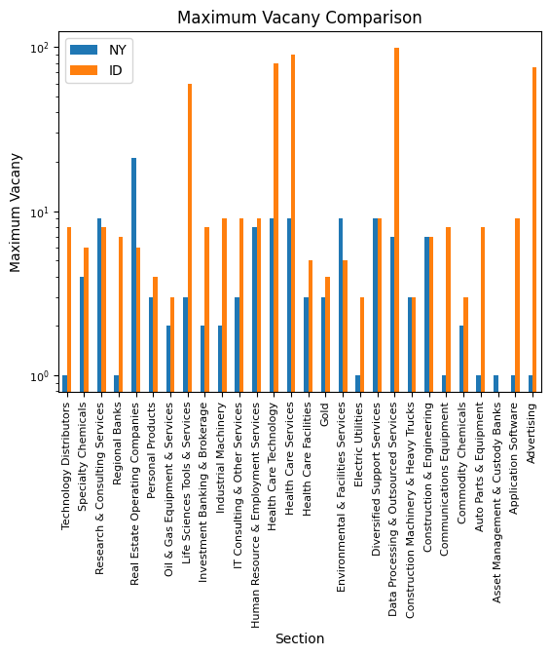
Data processing
Maximum vacancy comparison
Indian companies tend to hire more employee than New York companies do
Especially, the difference is about 10 times to 100 times in Advertising, Application Software or Technology Distributors sections
Source code:
query = "SELECT ny.description, ny.max_vacany as NY, id.max_vacany as ID \
FROM gny_df ny inner join gid_df id on ny.description = id.description \
order by ny.description desc"
max_vacany = spark.sql(query).collect()
max_vacany = spark.createDataFrame(max_vacany)
draw_chart(max_vacany, 'Maximum Vacany Comparison', 'Maximum Vacany', True)

Slide 25
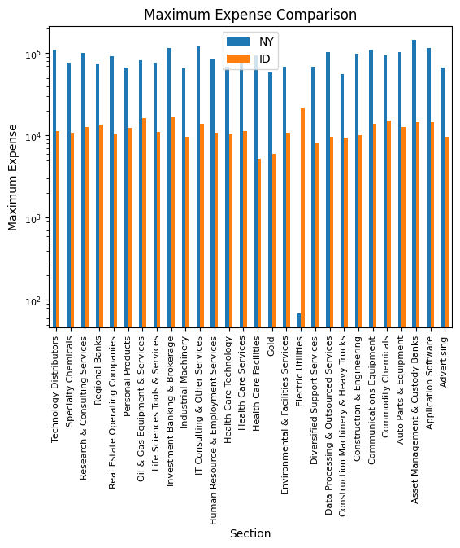
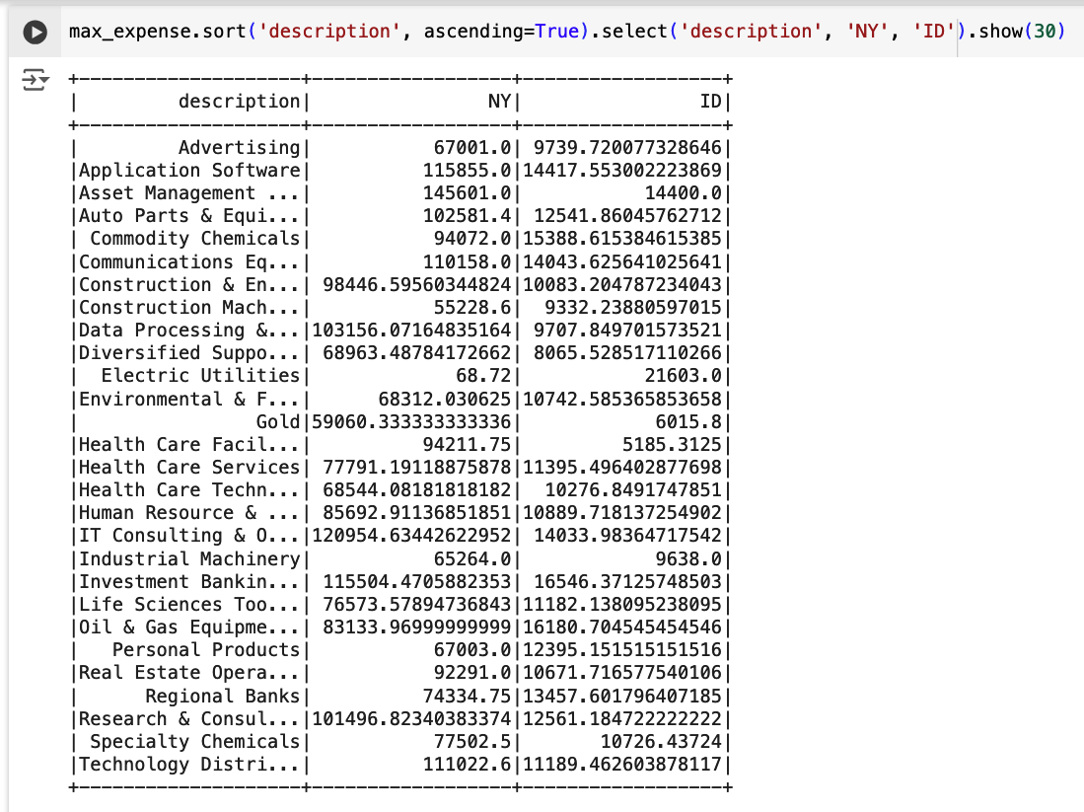
Data processing & Maximum expense

Slide 26
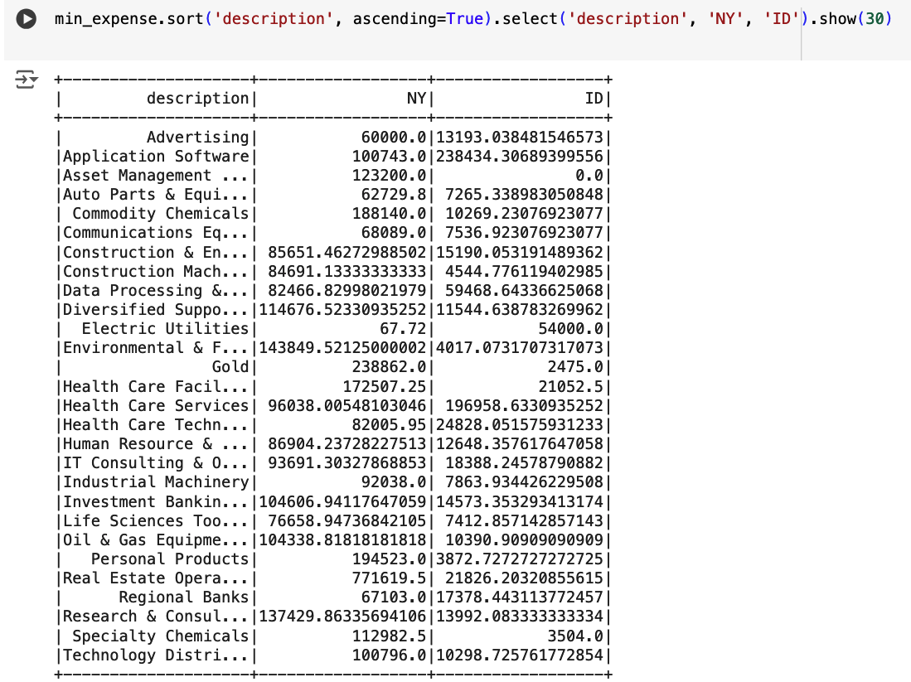
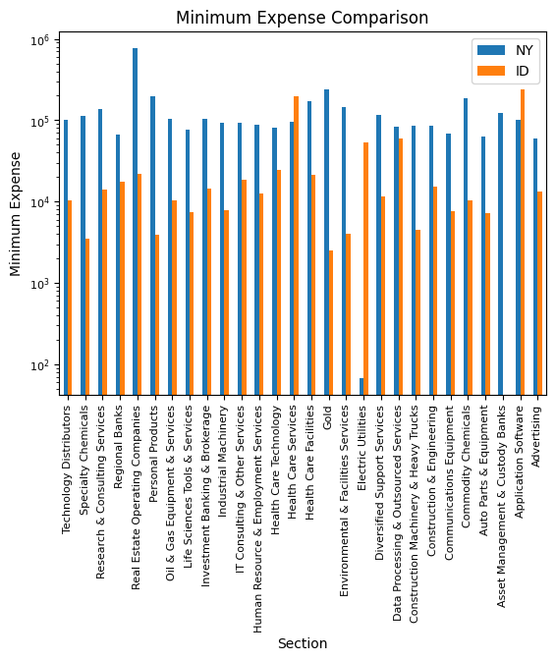
Data processing & Minimum expense

Slide 27
Thank you

